Slide 1

AIR QUALITY INDEX ANALYSIS
NARASARAOPETA ENGINEERING COLLEGE(AUTONOMOUS)
Under the gudiance of
M.Venkata Rao,( Assistant Professor)
Team Members
M.V.Jyoshna (19471A0534)
Ch.Chandana (19471A0507)
V.Sri Mallika (19471A0562)

Slide 2
ABSTRACT
Most of the industry applications create pollution in the air and the vehicle emissions are also dangerous to the health of the people.
In the developing countries, air pollution is severe in most of the areas.
Most of the air quality measuring systems uses air quality index to tell the people about the air quality of their location.
The primary objective of the system is to analyze and visualize air quality from the real time sensor data.
The proposed system analyses four critical air pollutants which are, Particulate Matter (PM2.5),Nitrogen dioxide (NO2) and Sulphur dioxide (SO2),RSPM are the most widespread health threats.

Slide 3
CONTENT
Introduction
Requirements
Literacture Survey
Proposed System
Data preprocessing
Data Visualization
Comparison of models
Output screen
Conclusion

Slide 4
INTRODUCTION
Air pollution monitoring is crucial in today's world, as it has a significant impact on both human health and the environment.
Harmful emissions not only affect the environment, but also impact the productivity and efficiency of individuals.
Thus, continuous monitoring is necessary to effectively control and mitigate air pollution.
Nitrogen dioxide (NO2), Sulphuric oxide (SO2), and Particulate Matter (PM) are the major contributors to air pollution.
These gases, which are produced from burning fossil fuels, wood, industrial boilers, and volcanic eruptions, cannot be seen or detected but can have serious impacts on human health.

Slide 5
REQUIREMENTS
Software Requirements
Browser : Any Latest Browser like Chrome
Operating System : Windows 10
Language : Python
Platform : Google COLAB
Hardware Requirements
Processor : Intel(R) Core™2 i5-5500U CPU @ 2.50GHz
RAM : 8GB(gigabyte)
System Type : 64-bit operating system, x64-based processor

Slide 6
Literacture Survey
Ziyue Guan and Richard O. Sinnot (2018) used the various machine learning algorithms to predict the PM2.5 concentration. Data were collected from the official website of Environment Protection Agency (EPA) for the city Melbourne that contains PM2.5 air parameter and they have also collected the unofficial data from Air beam which is the mobile device used to measure PM2.5 value [8].
Aditya C R (et al.2018) employed the machine algorithms to detect and forecast the PM2.5 concentration level on the basis of dataset containing atmospheric conditions in a specific city. They also predicted the PM2.5 concentration level for a particular date [10].
Kazem Naddaf (et al.2012) used the AirQ software proposed by WHO that provides the quantitative data on the impact of PM10, SO2, NO2 and O3 on the health of the people in Tehran City of Iran which is the most populated city in Iran [16]. Health impacts under the consideration were all cause mortality.

Slide 7
PROPOSED SYSTEM
Based on the problems of forecasting errors and risk of overfitting due to large datasets.
The data analyzed and sent to the company is resulted as inefficient and ineffective.
Thus to overcome the problem we are going to predict the Air Quality by using applied Randam Forest algorithm.
The proposed method for the project is explained on 7 steps :
Raw Data
Data Importing
Data Visualization
Testing Data
Predicted Air quality Values Using Algorithm
Algorithm

Slide 8
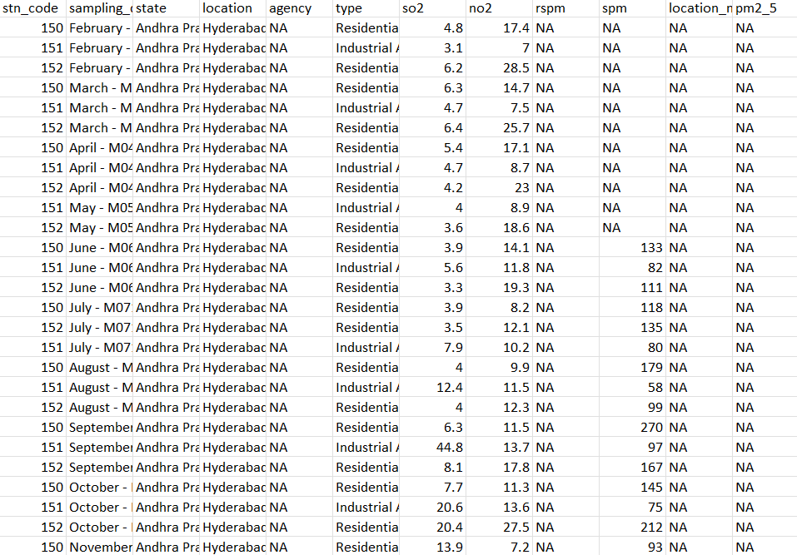
Fig: 3.5. Dataset
Fig 1: Dataset

Slide 9
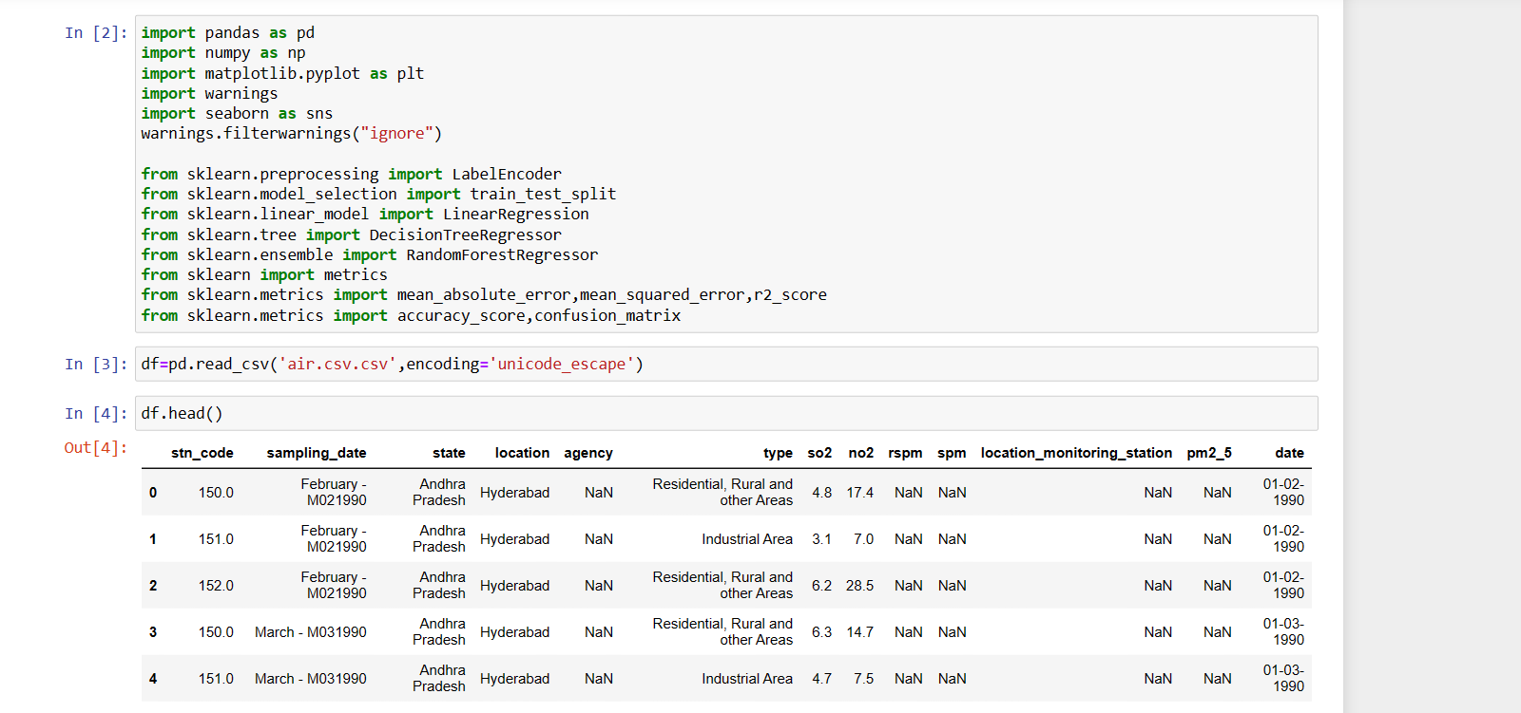
Data set
Fig 2: Importing and reading the dataset.

Slide 10
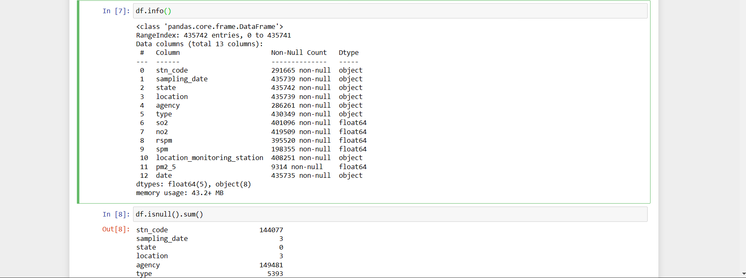
Data Preprocessing
Fig: 3: Checking null values and info of the dataset.

Slide 11
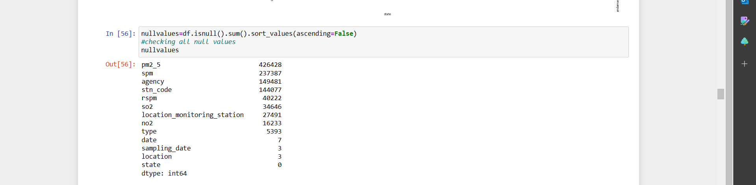
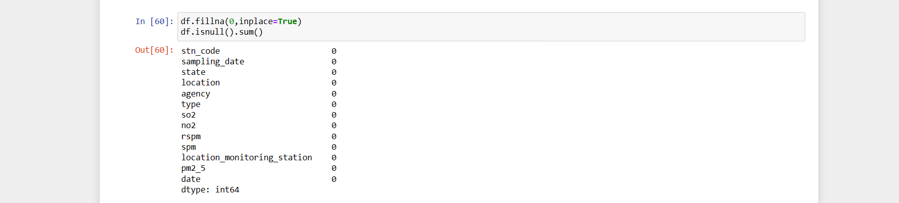
Filling Null values
Fig 6: filling null values with 0

Slide 12
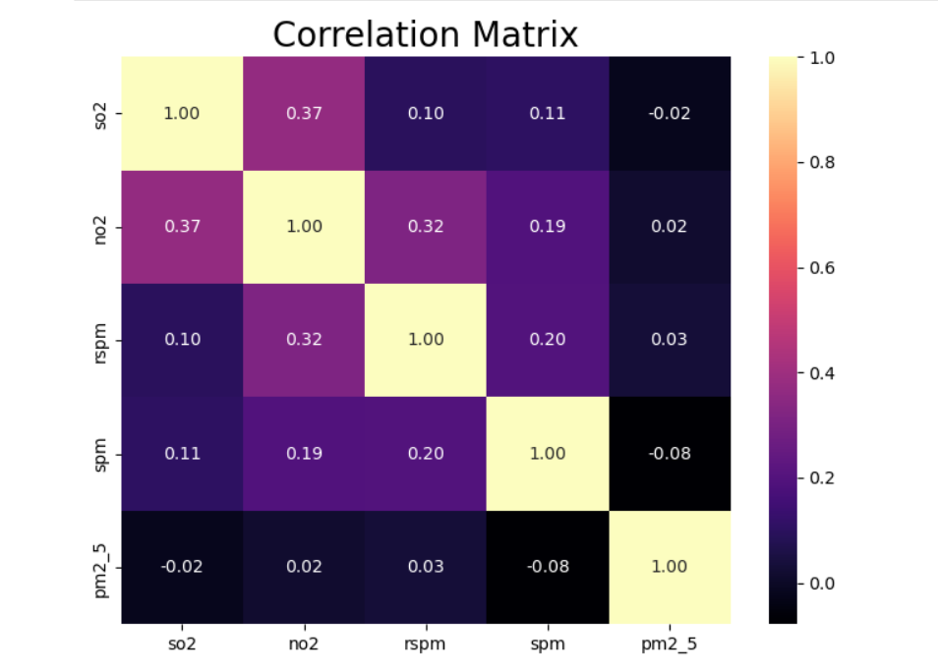
Correlation
Fig 5. Correlation

Slide 13
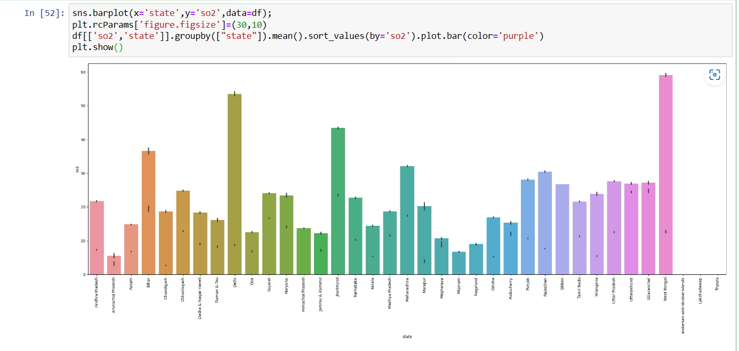
Data Visualization
Fig 4: plot between state and so2 gas

Slide 14
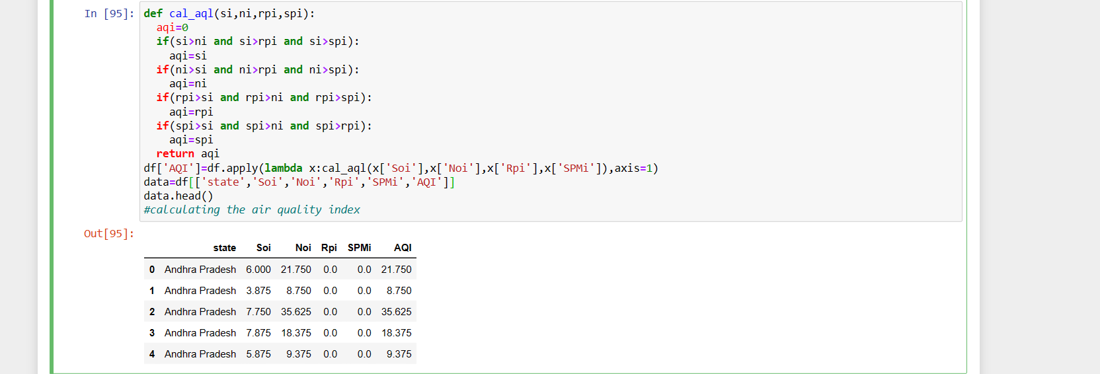
Calculating Air Quality Index value
Fig 7: Value of Air Quality index

Slide 15
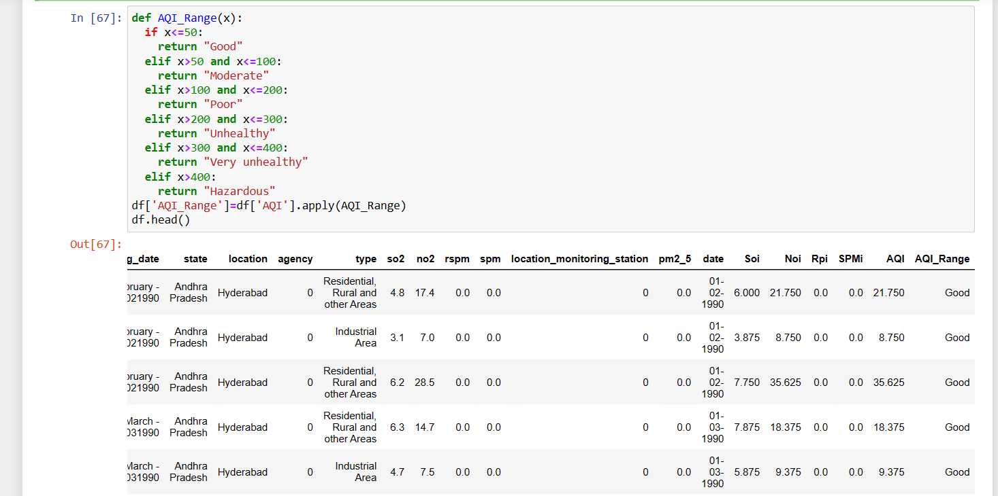
Air Quality Range
Fig 8: Range of air quality value

Slide 16
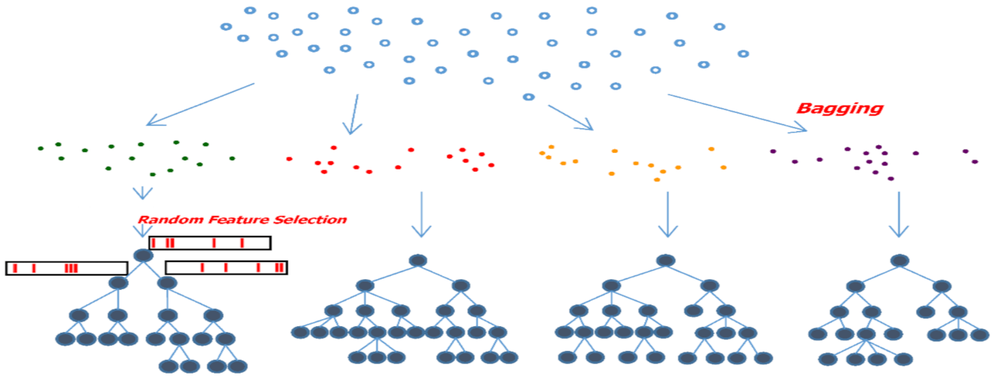
Random Forest Algorithm
The algorithm used is involved on the concept of Random Forest algorithm. which belongs to supervised learning. There is labeled data for this clustering, unlike in unsupervised learning.
Among all the available classification methods, random forests provide the highest accuracy. The random forest technique can also handle big data with numerous variables running into thousands. It can automatically balance data sets when a class is more infrequent than other classes in the data
Fig 9: Random Forest

Slide 17
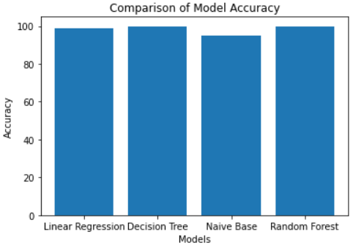
Comparison among Models
Fig 10:Accurancy

Slide 18
Accuracy among models
ALGORITHM | ACCURACY
Linear Regression | 98.30
Decision Tree Classification | 99.95
Naïve base Classification | 95.06
Random Forest | 99.96

Slide 19
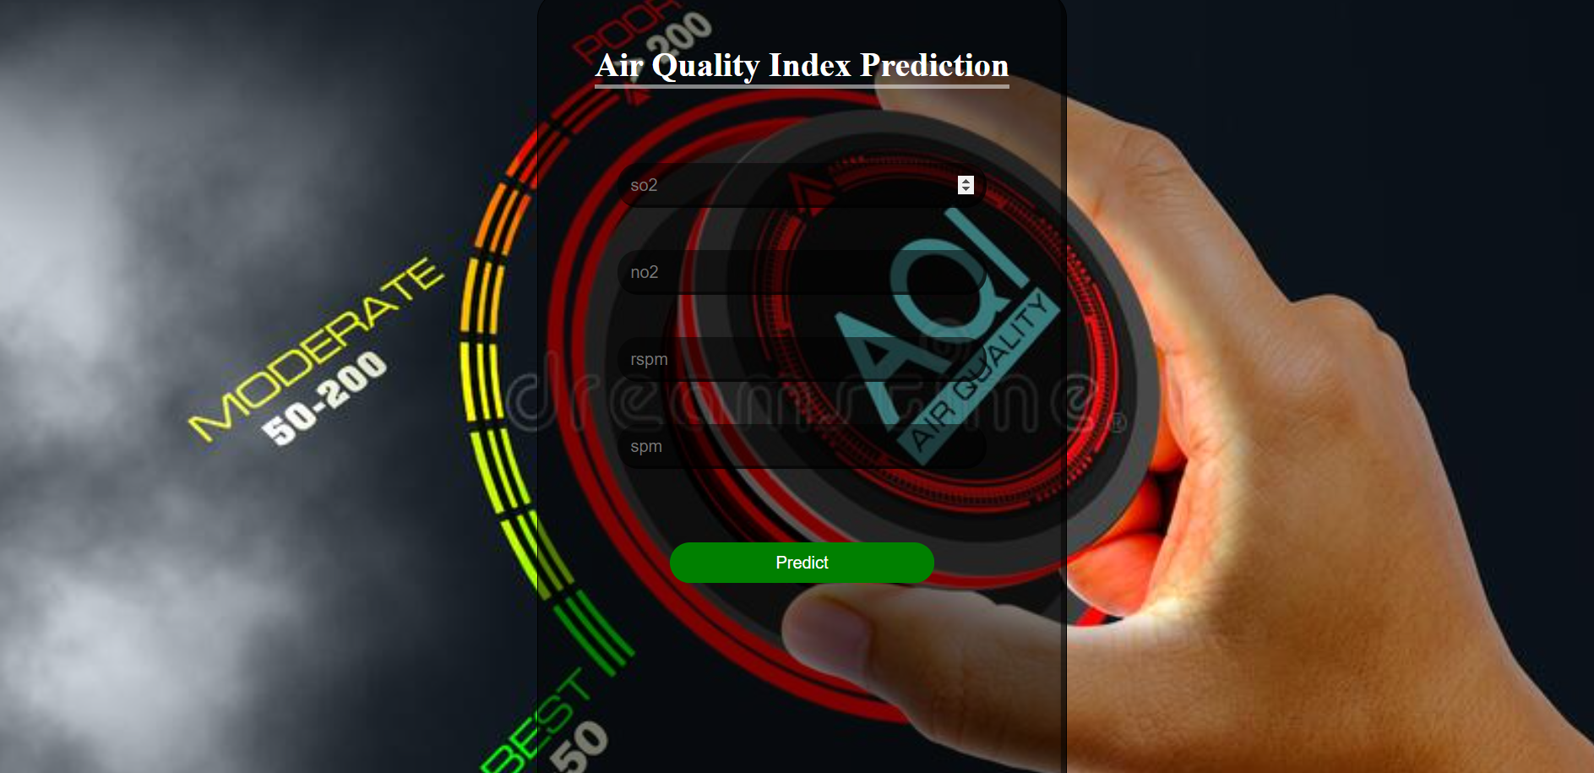
Fig 11: web page of Air Quality index

Slide 20


Fig 12: Output Page

Slide 21
CONCLUSION
The conclusion of the project is to find the air quality range by giving the values of gases so that we can get the result by using the best accuracy model Random Forest.
While installing the air quality devices, it is easy to measure the quality of the environment and it becomes easy to reduce the pollution of the environment.
The merit of the project is that it explains the functioning of how to measure the value of air quality based on an unsupervised algorithm and also explains the key concepts of machine learning.

Slide 22


